Slide 1
What is a project?

Slide 2

What does it mean by a politician when he says

Slide 3
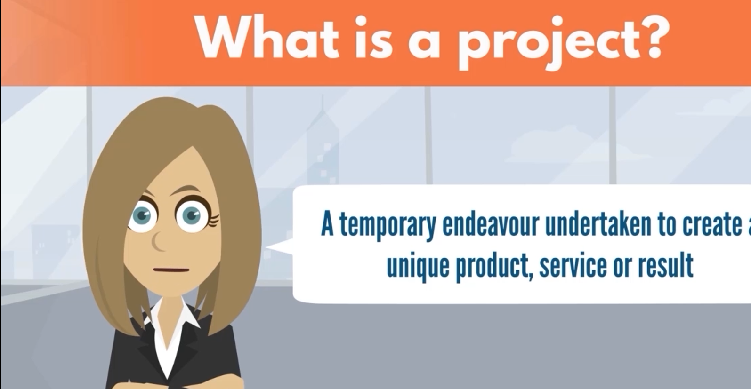

Slide 4
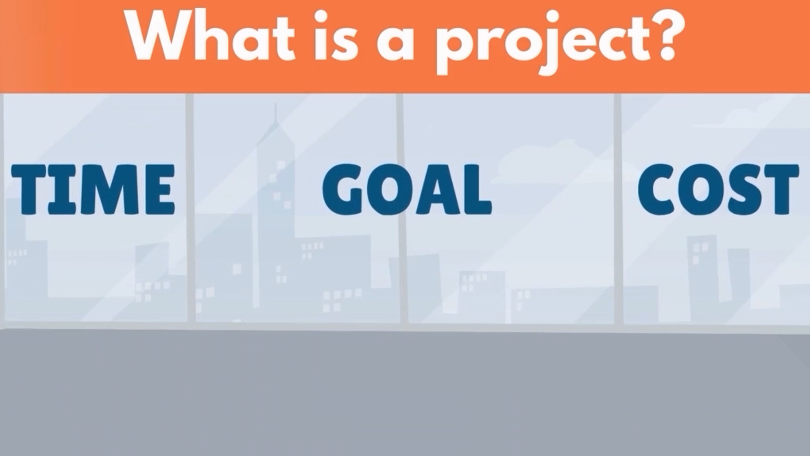

Slide 5
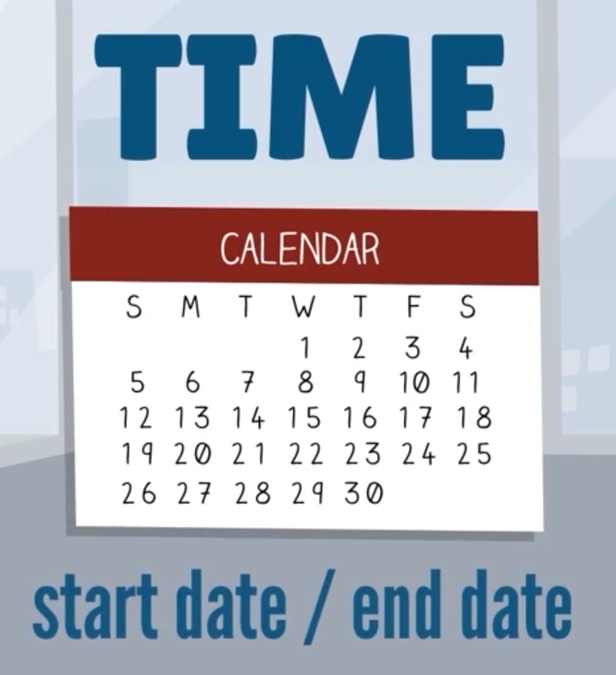



Slide 6



Slide 7
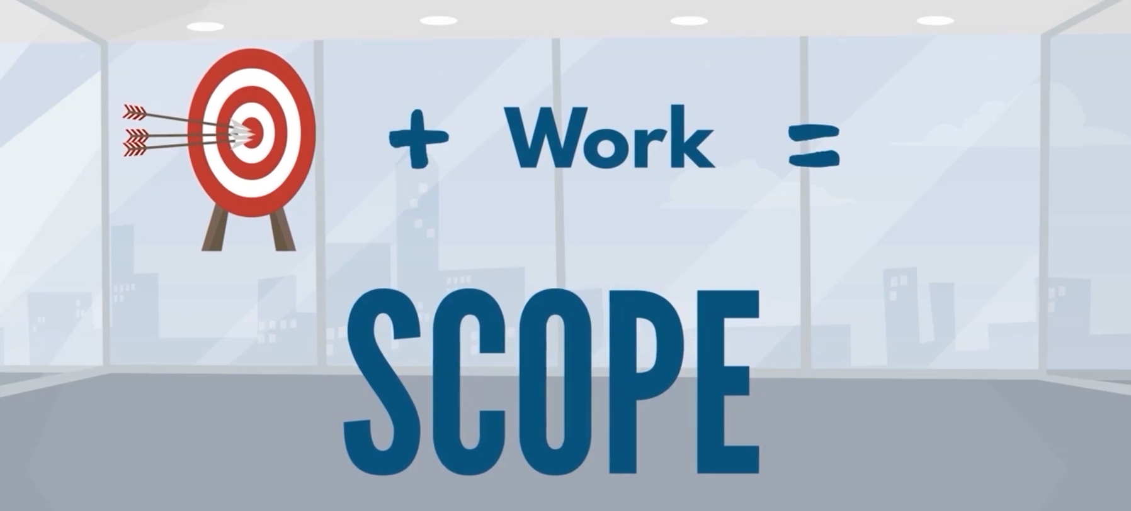
The scope of a project is always unique

Slide 8


Slide 9
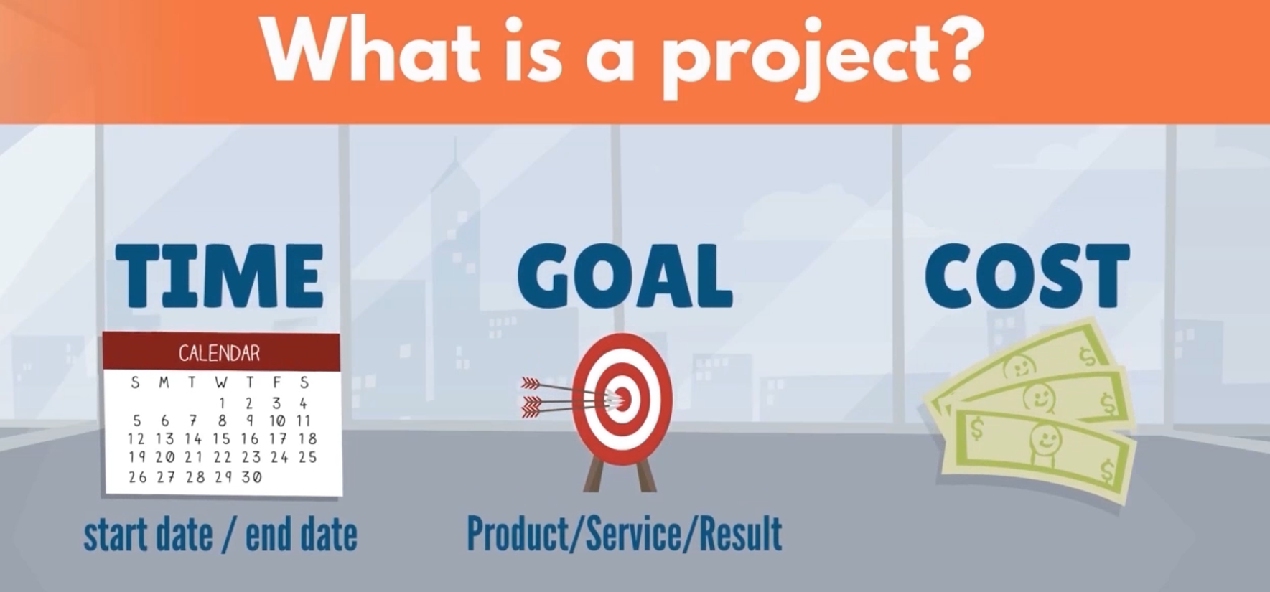

Slide 10
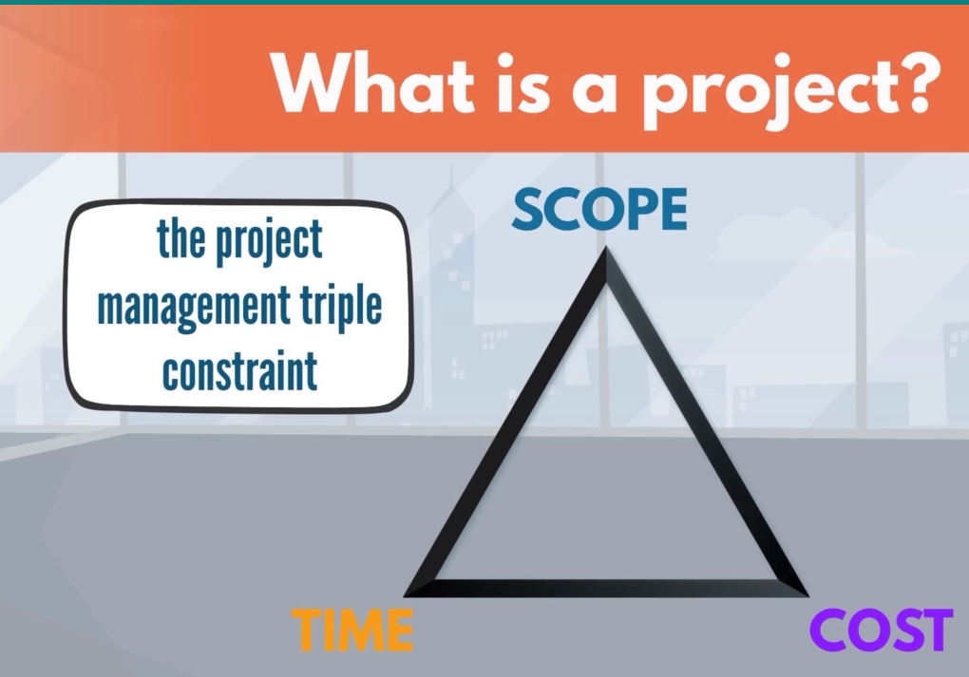
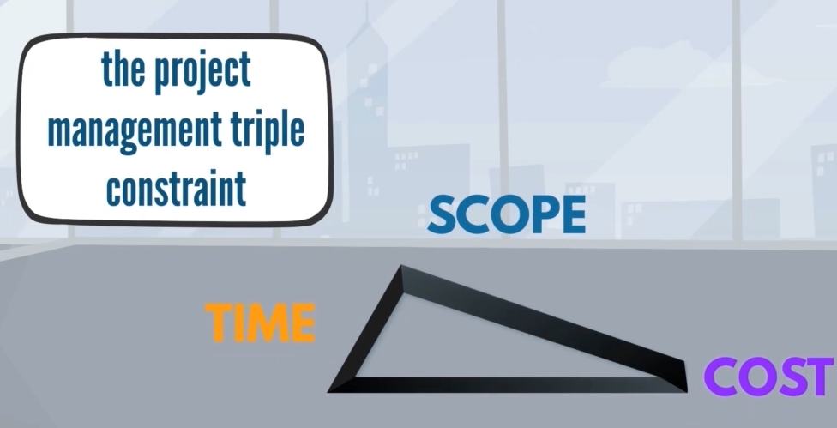
Notes:
The three factors that compose the project are dependent on one another. If changes occur, other factors will be affected

Slide 11
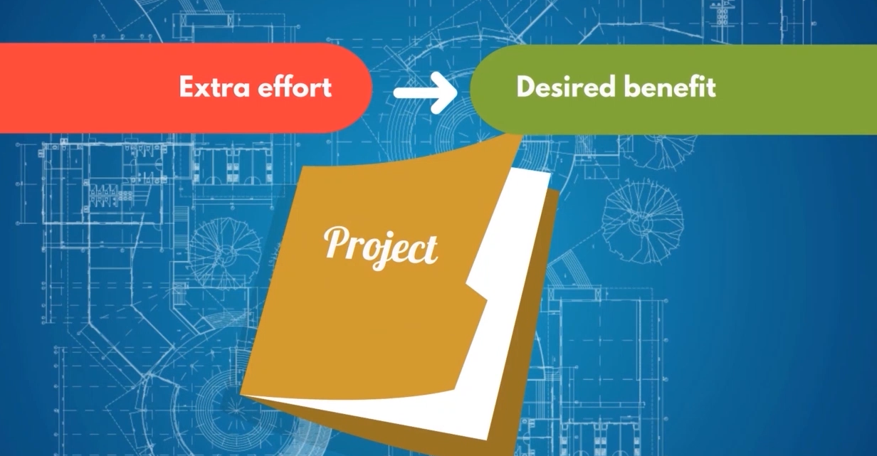
Why do businesses invest in projects?

Slide 12
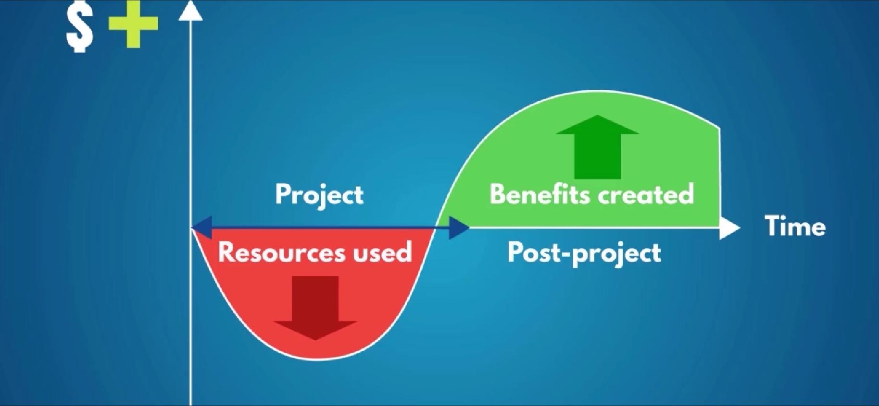

Slide 13
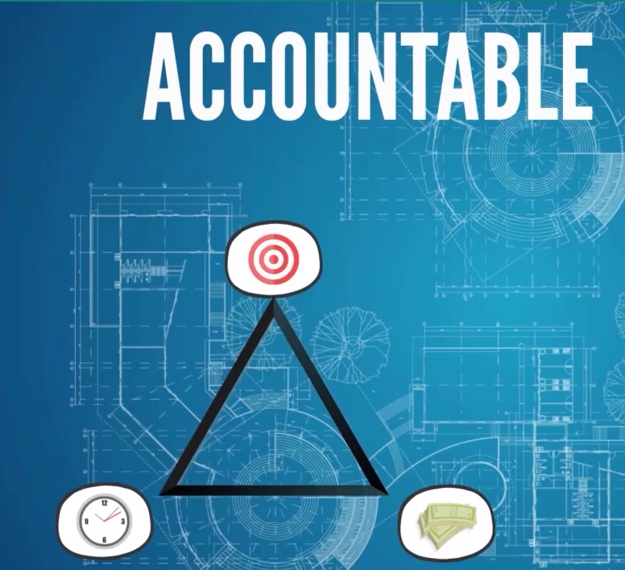
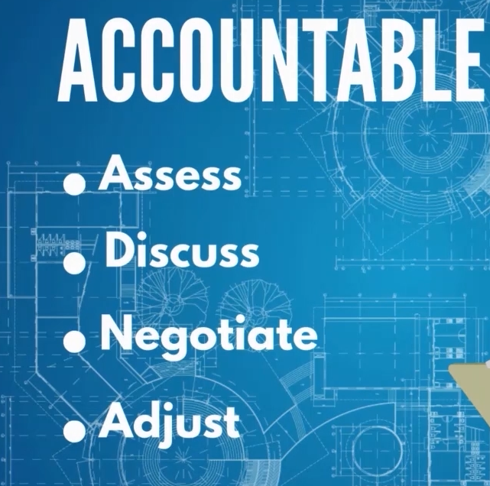
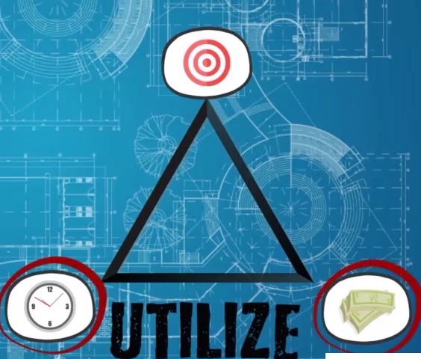
Role of a Project Manager
CEO of the project
Notes:
PM – accountable for the project to be successful under the 3 constraints ( goal/target, time and money)
What id the budget and time are insufficient? PM is responsible to assess, discuss, negotiate and adjust…
Target versus Realistic expectation??? – need to utilize the resources

Slide 14
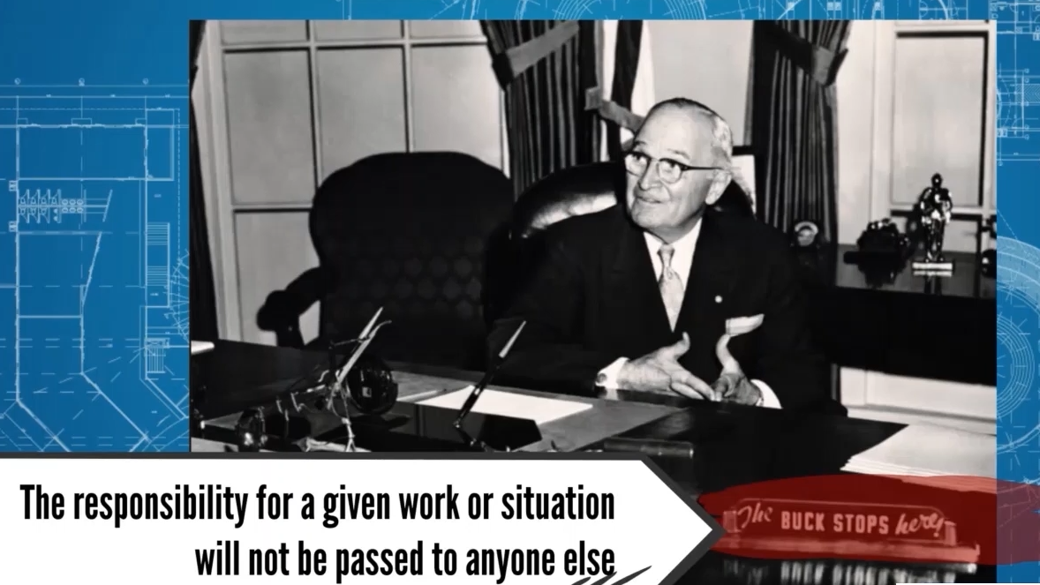
What does accountable mean?
Notes:
Who is this guy?U.S. Pres. Harry Truman
Accountable means not just to commit but to deliver
PM accountable for the tasks of all related parties (managers, vendors, and other stakeholders)
PM has full control on the project and solve immediately the problem that arises. Immediately take action

Slide 15
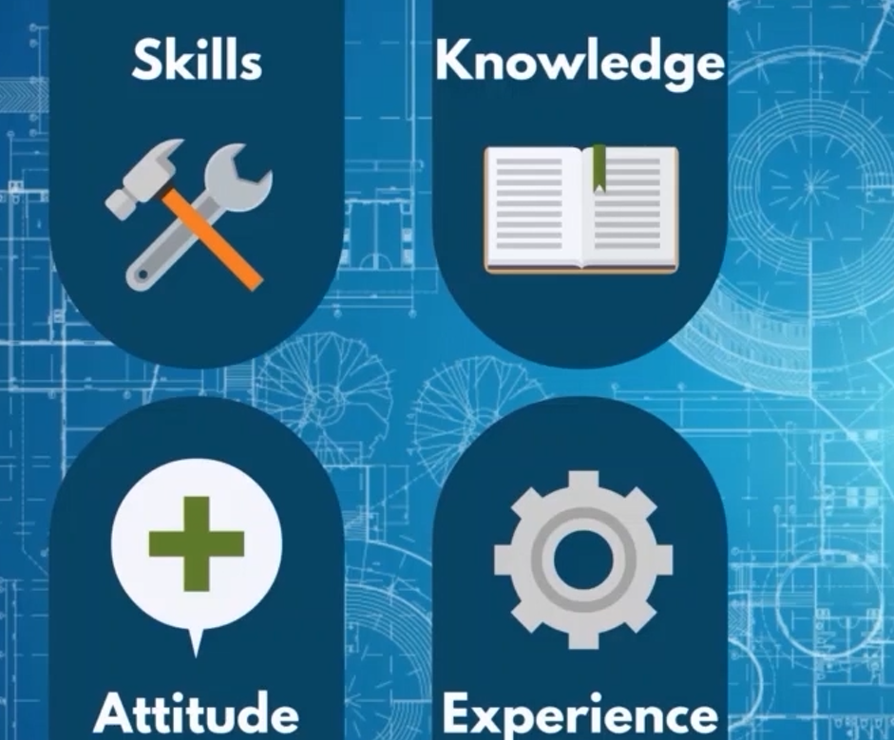
Attributes of PM

Slide 16
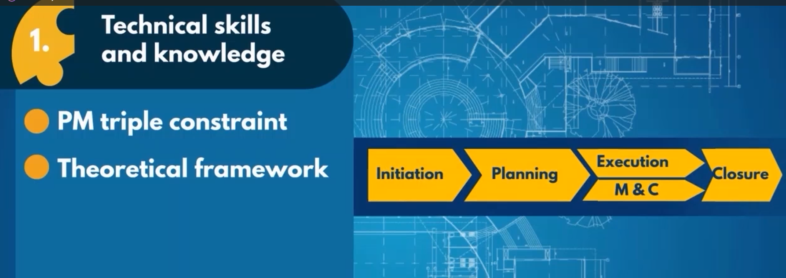

Slide 17
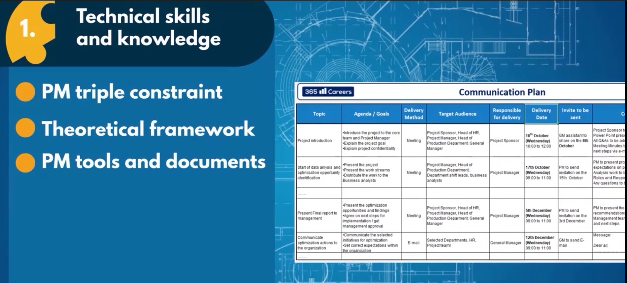

Slide 18
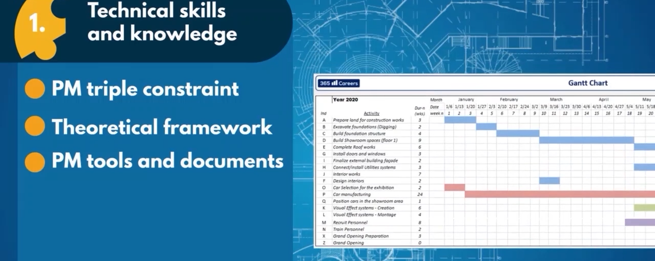

Slide 19
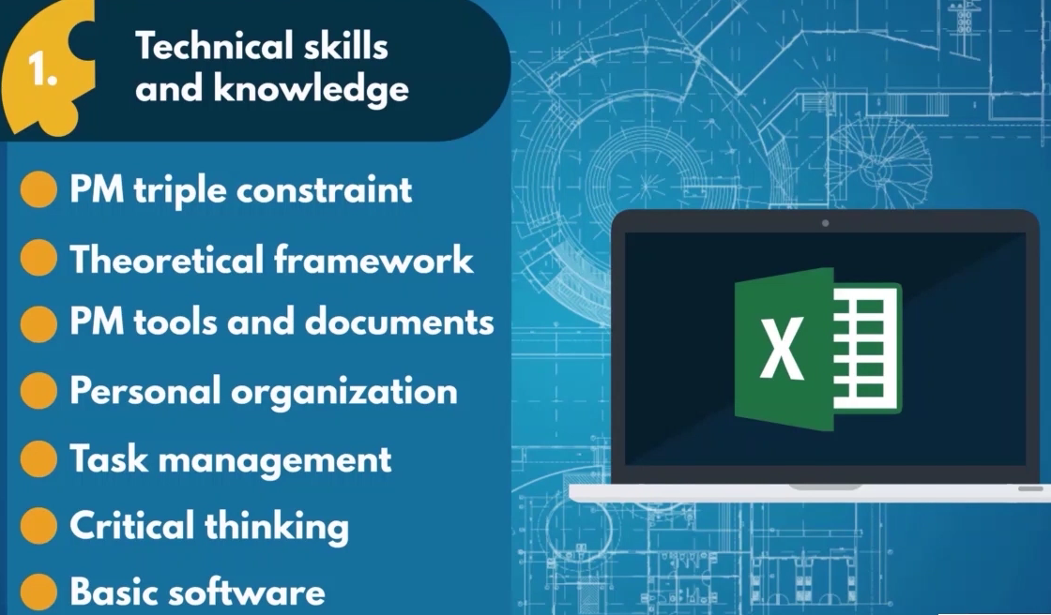

Slide 20


Slide 21


Slide 22
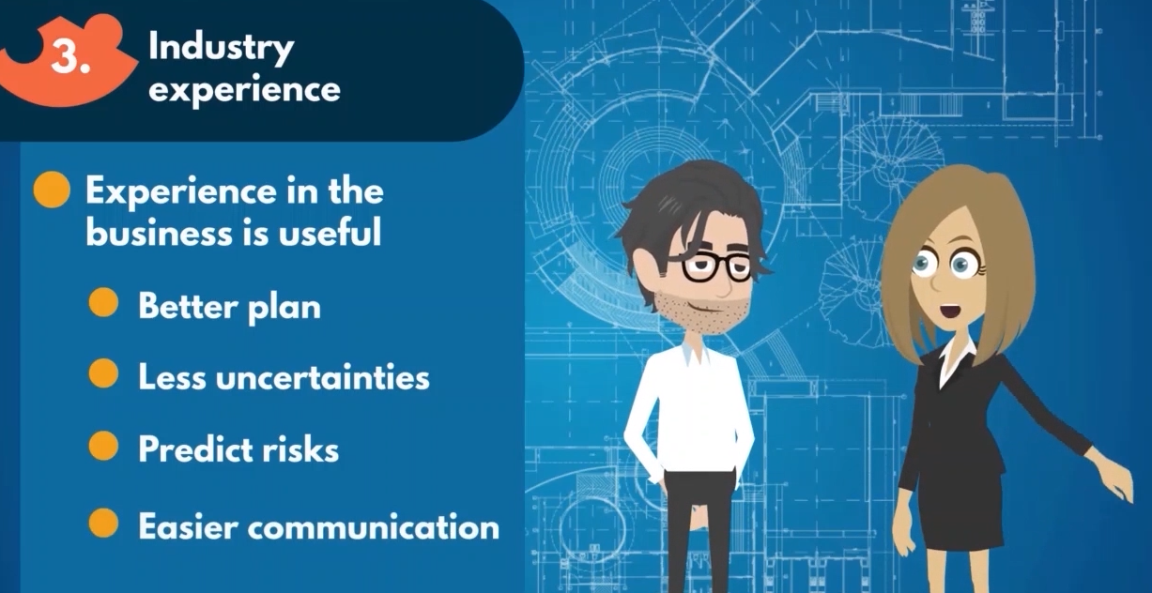

Slide 23
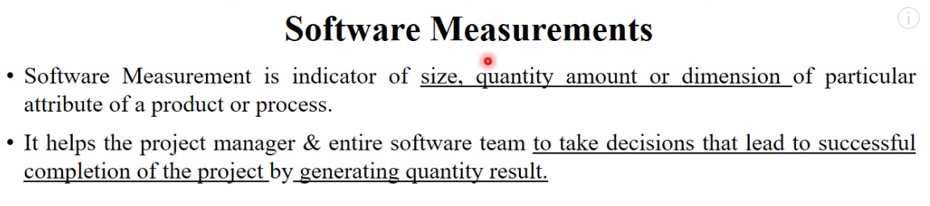
Software Process and Project Metrics
Software Project Estimation
Notes:
Size – complete size of the project
Quantity amount or dimension – how many resources – hardware, software , human resources are required for a particular project

Slide 24
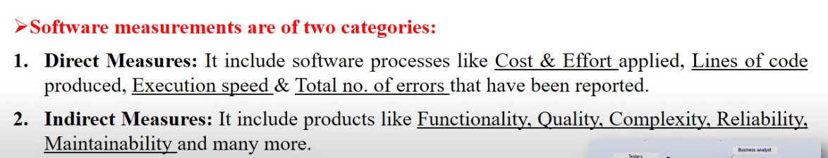
Measures, Metrics and Indicators
a measure provides a quantitative indication of the extent, amount, dimensions, capacity, or size of some attribute of a product or process
  Example: Speed expressed in km/h, or temperature expressed in ºC, or beer as a pint.
Notes:
*metric – example total number of errors occur per hour

Slide 25
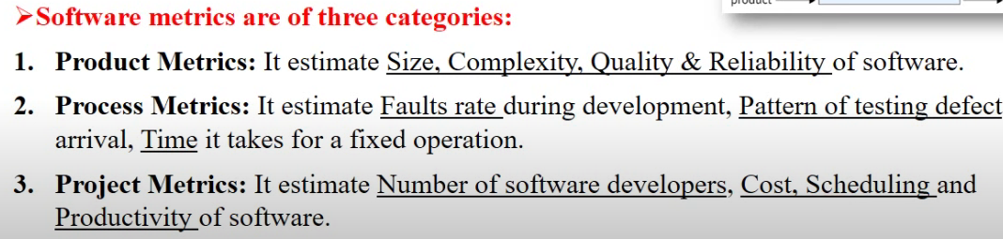
a metric is a quantitative measure of the degree to which a system, component, or process possesses a given attribute
Definition: The term metric has more of a goal or performance nuance to it, as opposed to measure, a fundamental or unit-specific term.
  Example: Speed limit of 50 km/h, or the boiling temperature of 100 ÂºC, or ordering half a pint of beer.

Slide 26
an indicator is a metric or combination of metrics that provide insight into the software process, a software project, or the project itself; it provides insight that enables the project manager or software engineers to adjust the process, the project, or the product to make things better

Slide 27
Process and Project Indicators
Process indicators
➢ enable a software engineering organization to gain insight into the efficacy of an existing process
Project indicators
➢ enable a software project manager to
  1. assess the status of an ongoing project,
  2. track potential risks,
  3. uncover problem areas before they go critical,
  4. adjust work flow or tasks,
  5. evaluate the project team’s ability to control quality software engineering work products

Slide 28
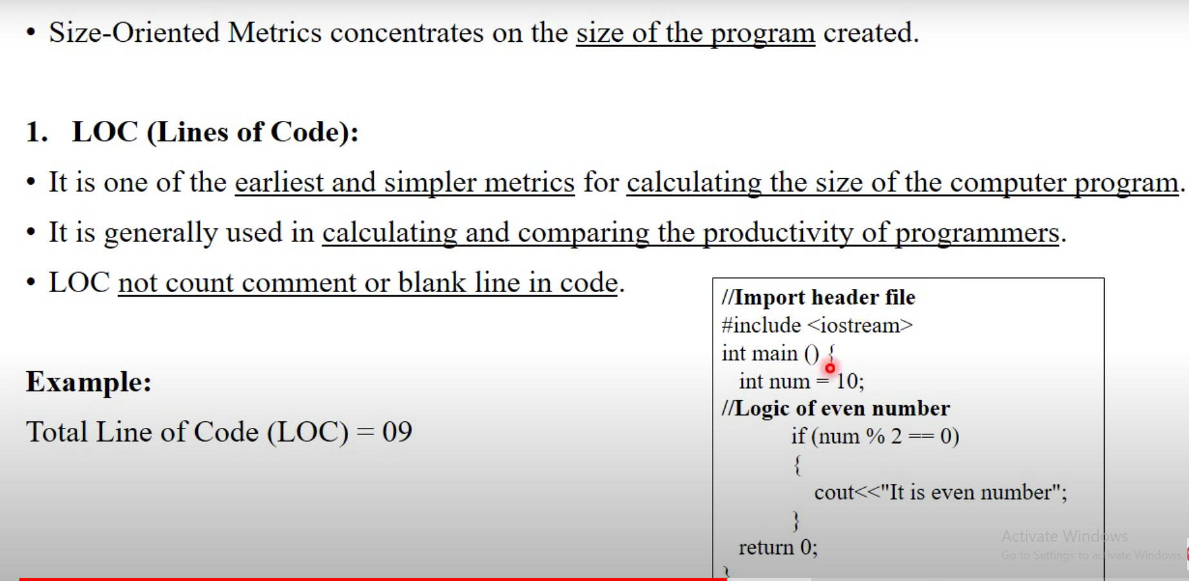
Size metric - LOC

Slide 29
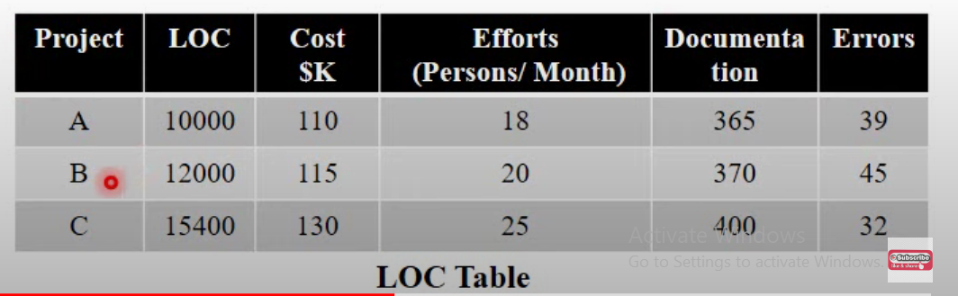
Notes:
Cost per 1,000 line

Slide 30
What is a key performance indicator (KPI)?
Definition: KPIs are relevant performance metrics that are measurable to industry, department or task. KPIs are evaluated over a specified time period, and compared against acceptable norms, past performance or targets.

Slide 31
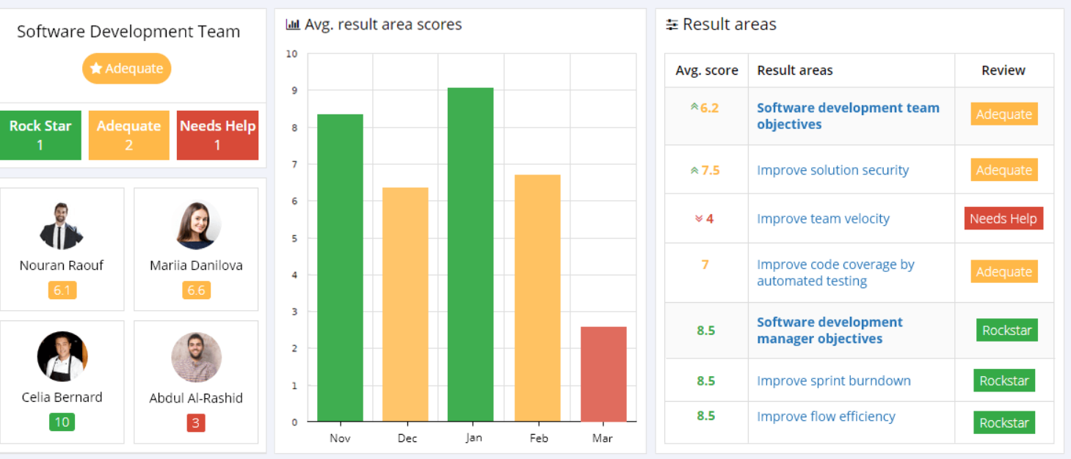
Example
Notes:
Software Developer Objectives
Software Development team objectives

Slide 32
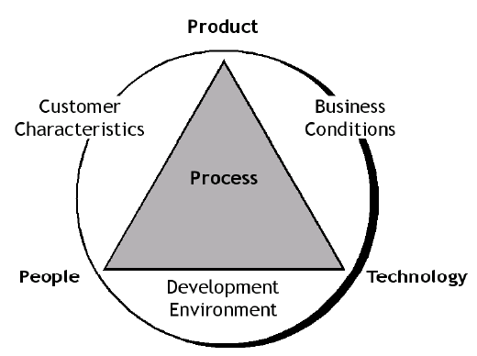
Process Metrics

Slide 33
Estimating
What is a project and a WBS?
Project characteristics
  Has start and end dates
  Has set objectives
  Uses resources within limits
Work Breakdown Structure
  Activities necessary to attain project objectives
  Hierarchically structured (often executed iteratively)
  Relates to life cycle

Slide 34
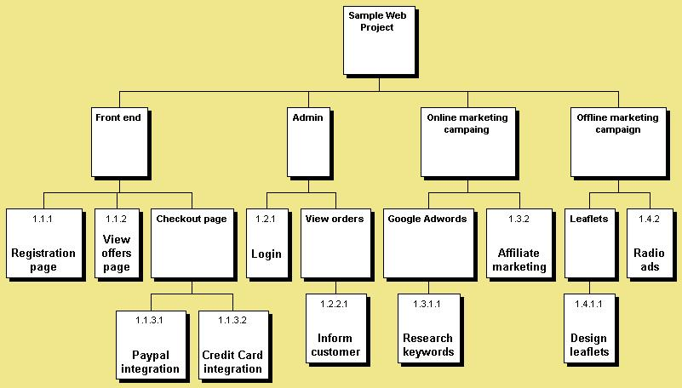

Slide 35
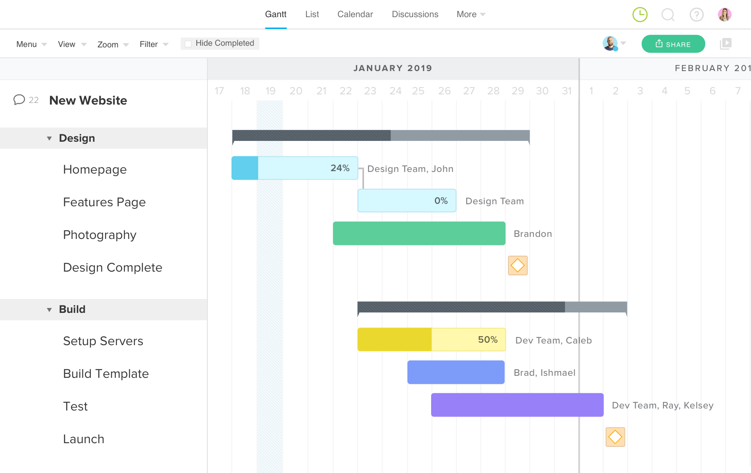

Slide 36
Estimating Principles
Invest in the estimate
Apply correct amount of resources to create and refine the estimate
Understand the options
The estimate of the resources required for a given scenario cannot be arbitrarily changed
Improve the estimate
Re-estimate often as more information available

Slide 37
Estimating
Estimate
The approximate measure of size, effort, duration and staff required to complete a project
Size
The measure of how ‘big’ the product is
Effort
The number of people hours required to complete an activity

Slide 38
Estimating
Duration
The number of calendar days from start to end of an activity
Staff
The number of people applied to an activity (full or part-time)
Assumptions
Conditions of the project, environment or personnel considered true for estimate
Risk
Chance of damage, injury or failure resulting from estimate

Slide 39
Estimating
Metric
Quantitative measure of degree of possession of attribute
Requirement
Assertion that must be true for product to be acceptable to customer
Constraint
Requirement reflecting decision that cannot change
Expectation
Assertion that must be true for product to achieve complete customer satisfaction

